Slide 1
Bubble Sort
An Archaelogical Algorithmic Analysis
Owen Astrachan
ola@cs.duke.edu
http://www.cs.duke.edu/~ola
NSF CAREER 9702550 CRCD 0088078

Slide 2
Bubble sort: what can we study?
What is bubble sort and what are its origins?
  When did it appear, when was it named?
Why is bubble sort studied and why is it popular?
  Do bubble sorters fly in the face of expert opinion?
What do the experts say about bubble sort?
  What makes someone an expert?
    Turing, Grace Hopper, Karlstrom, SIGCSE Award winners
What do we learn from algorithm archaelogy?
  Libraries, Google, and the Internet are amazing

Slide 3

Why Bubble is not my Favorite Sort
1973: Wrote my first program
  Biorhythms in BASIC
1975: First formal CS course
  Programming as trial and error, no elegance
1977: Sysprog ‘ls’ in DXPL
  I use bubble sort!
1980: Teach using Apple II
  High school BASIC
1985: Teach using IBM PC
  College Pascal

Slide 4


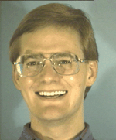
Genesis of Paper
Wolfman & Pottinger (Ernst)
  Taste’s great!, Less filling!
[I recall] ‘A human sorting algorithm in which students were to sort themselves by ID using bubble sort --- the instructor set us off with an exuberant "Go!" After several frantic seconds of inter-student hubbub and instructor protestation we were sorted, leaving the Great Master lamenting that “only one person gets to talk at a time!!” ’

Slide 5

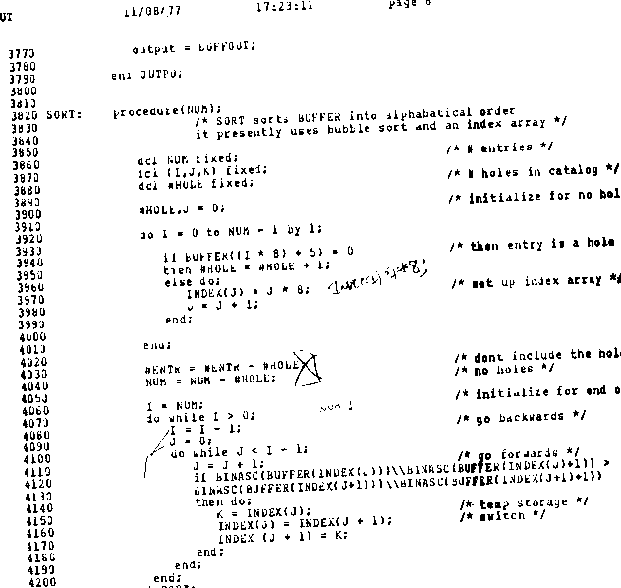
11/08/77

Slide 6
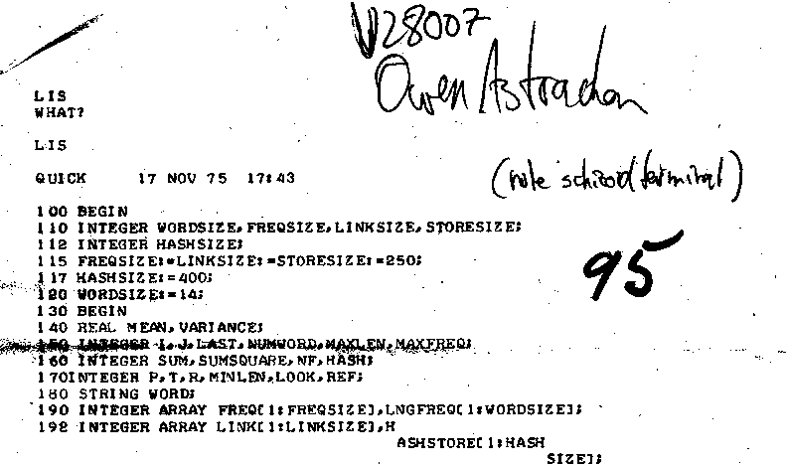
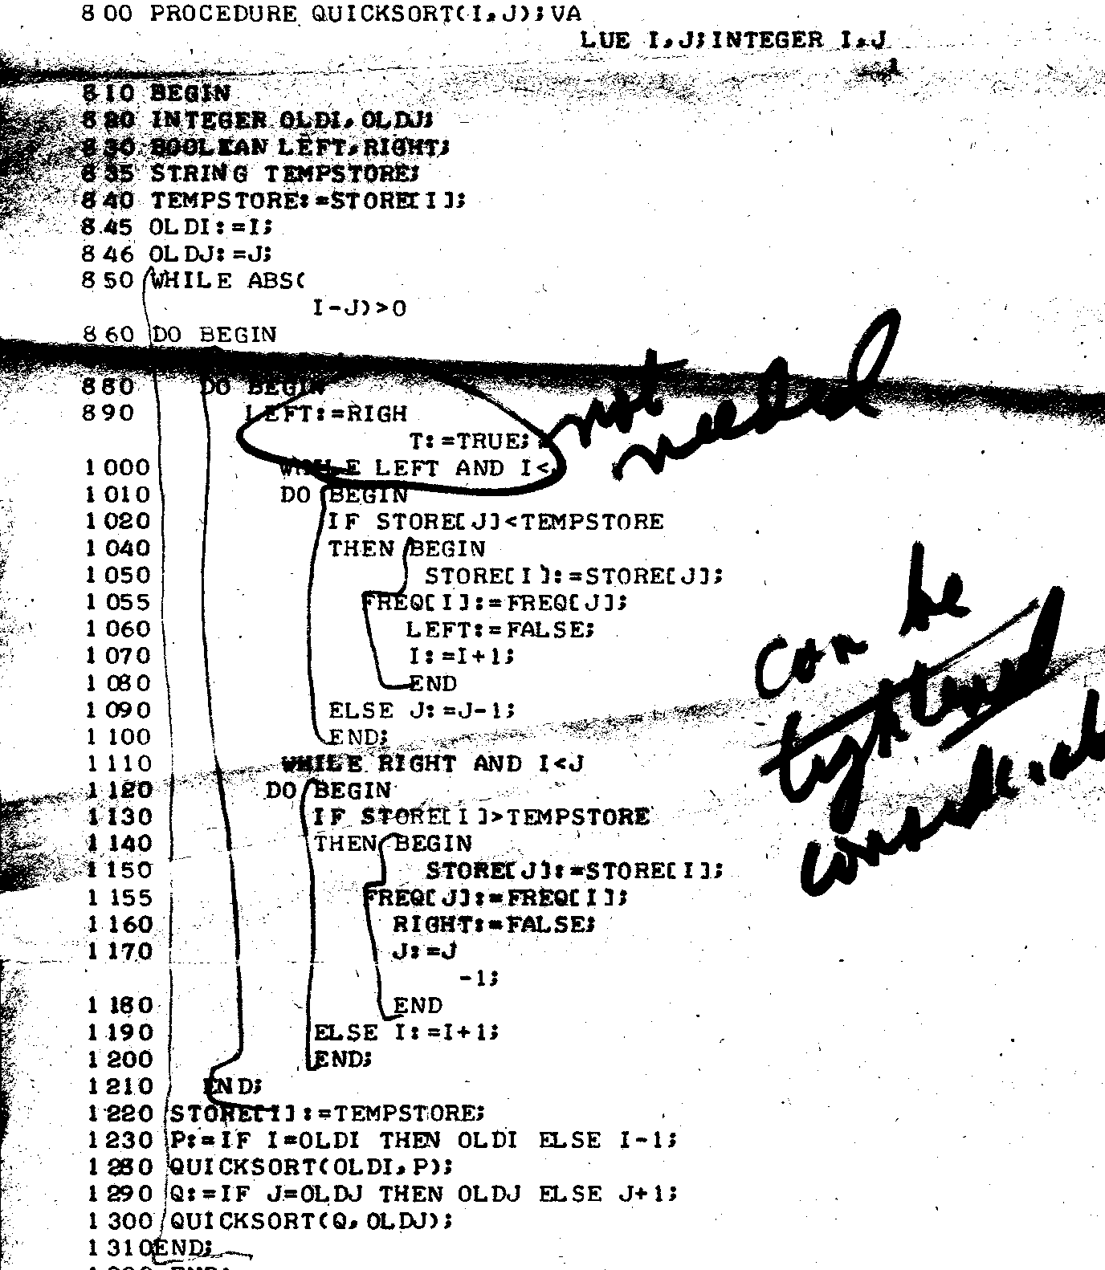
17 Nov 75
Not needed
Can be tightened considerably

Slide 7
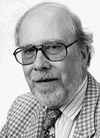
Niklaus Wirth (Turing award 1984)
I have read your article and share your view that Bubble Sort has hardly any merits. I think that it is so often mentioned, because it illustrates quite well the principle of sorting by exchanging.
I think BS is popular, because it fits well into a systematic development of sorting algorithms. But it plays no role in actual applications. Quite in contrast to C, also without merit (and its derivative Java), among programming codes.

Slide 8
Bubble Sort: The code
void BubbleSort(Vector a, int n)
{
for(int j=n-1; j > 0; j--)
for(int k=0; k < j; k++)
if (a[k+1] < a[k])
Swap(a,k,k+1);
}
What happens if k+1 becomes j ?
How do we stop early?
What about alternating directions?
Correctness: terminating, sorted, permutation.

Slide 9
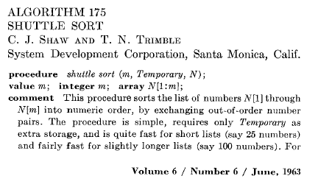
Shuttle/Bubble becomes official

Slide 10
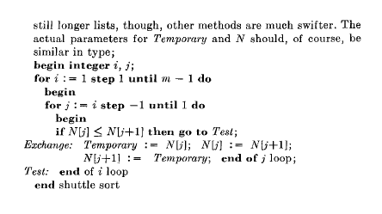
Algorithm 175: The code

Slide 11
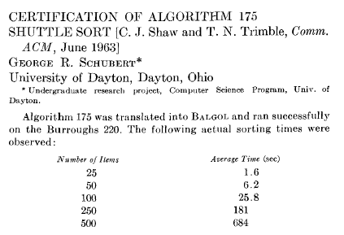
Certification of Algorithm 175

Slide 12

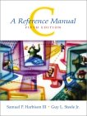
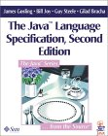
Guy L. Steele, Jr. (Hopper ’88)
(Thank you for your fascinating paper and inquiry. Here are some off-the-cuff thoughts on the subject. )
I think that one reason for the popularity of Bubble Sort is that it is easy to see why it works, and the idea is simple enough that one can carry it around in one's head …
continued

Slide 13
Guy L. Steele, Jr. (continued)
When I was a teenager, I knew about and sometimes used the following "even worse" version of Bubble Sort:
do {
swapflag = false;
for (int j=n-1; j > 0; j--) {
if (a[j+1] < a[j]) {
Swap(a,j,j+1);
swapflag = true;
}
}
} while (swapflag);
I no longer remember on what street corner I picked this up.

Slide 14
Guy L. Steele, Jr.
As for its status today, it may be an example of that phenomenon whereby the first widely popular version of something becomes frozen as a common term or cultural icon. Even in the 1990s, a comic-strip bathtub very likely sits off the floor on claw feet.
… it is the first thing that leaps to mind, the thing that is easy to recognize, the thing that is easy to doodle on a napkin, when one thinks generically or popularly about sort routines.

Slide 15
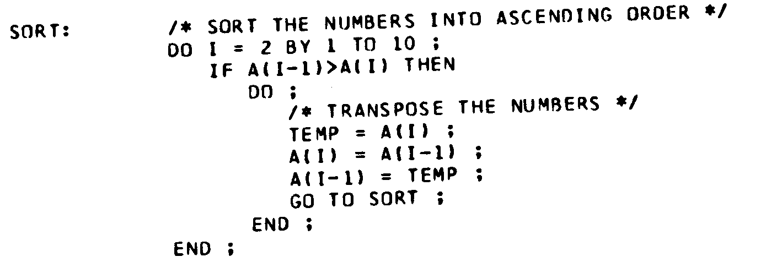
Non-archaelogical analysis
Frank Bates and Mary Douglas
  Prentice-Hall 1967, Programming Language One
  Answer to “sort the array exercise” in book
What is the complexity of this sort (substitute N for 10)

Slide 16
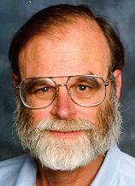
Jim Gray (Turing 1998)
Bubble sort is a good argument for analyzing algorithm performance. It is a perfectly correct algorithm. But it's performance is among the worst imaginable. So, it crisply shows the difference between correct algorithms and good algorithms.
(italics mine)

Slide 17
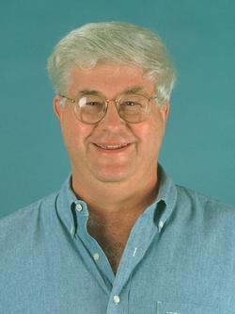
Brian Reid (Hopper Award 1982)
Feah. I love bubble sort, and I grow weary of people who have nothing better to do than to preach about it. Universities are good places to keep such people, so that they don't scare the general public.
(continued)

Slide 18
Brian Reid (Hopper 1982)
I am quite capable of squaring N with or without a calculator, and I know how long my sorts will bubble. I can type every form of bubble sort into a text editor from memory. If I am writing some quick code and I need a sort quick, as opposed to a quick sort, I just type in the bubble sort as if it were a statement. I'm done with it before I could look up the data type of the third argument to the quicksort library.
I have a dual-processor 1.2 GHz Powermac and it sneers at your N squared for most interesting values of N. And my source code is smaller than yours.
Brian Reid
who keeps all of his bubbles sorted anyhow.
Good paper, by the way. Well written and actually has something to say.

Slide 19
A Bubble by any other name…
Official ACM version is shuttle sort (accepted wisdom, but…)
Using Knuth and 1962 Sorting conference as a start, early papers and books all use “exchange sort” as the name
  Demuth doesn’t recall knowing sort as “bubble”
1962: Iverson’s A Programming Language uses “bubble sort”
Subsequent works using “bubble sort” reference Iverson
Reasonable evidence that Iverson’s work is first occurrence of bubble sort in print --- not conclusive, but Occam’s razor?

Slide 20
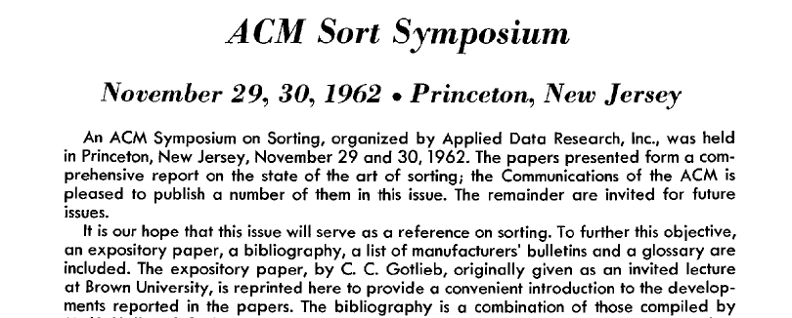
Sorting State of the Art circa 1962

Slide 21
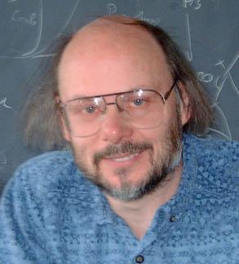
Bjarne Stroustrup (Hopper Award 1993)
The only use of Bubble sort that I can think of is as "before" in a "before and after" study. It can be a good example of what not to do. I regularly get questions from relatively novice programmers who worry about "which sort algorithm to use" when they would be perfectly happy with the performance and interface of the standard library C++ sort() for problems 100 times larger and far more complex than what they have. Worse, they couldn't write a better sort if they tried.

Slide 22
Bjarne Stroustrup (Hopper 1993)
Maybe (some) early programming teaching fail in giving students the impression that they need to write their own sorts? Another thing that people sometimes forget is that if you ever so infrequently sort 100 elements in a typical program, it doesn't really matter much which algorithm you use: unless your comparison function is horrendously slow, the average programmer wouldn't have a clue how to measure the minute time difference.

Slide 23
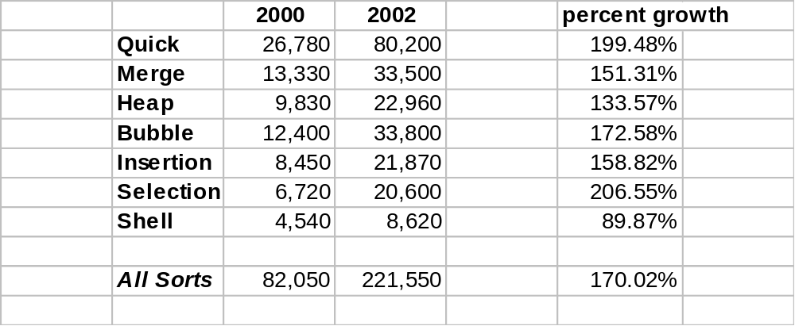
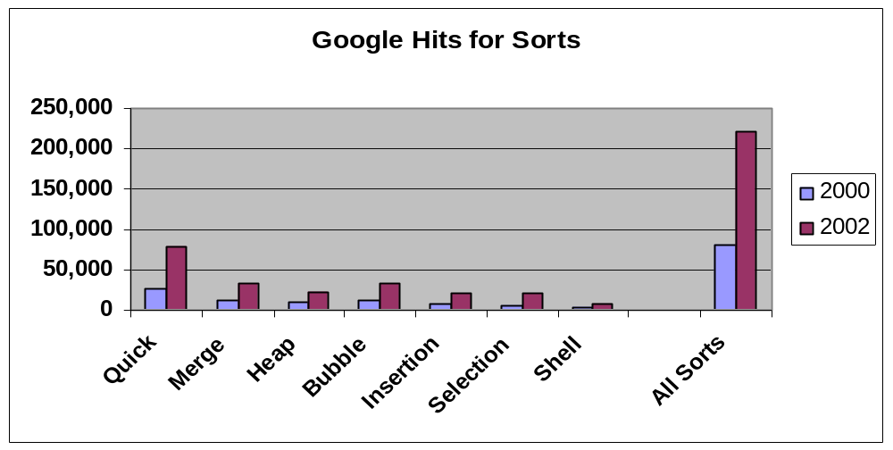
Popularity?

Slide 24
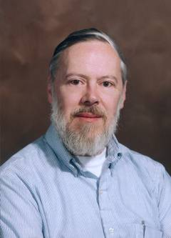
Dennis Ritchie (Turing Award 1983)
… in the mention of K&P Software Tools, you might observe that the apparent purpose of mentioning bubble first is to knock it down, since the n² behavior is stressed right away.

Slide 25
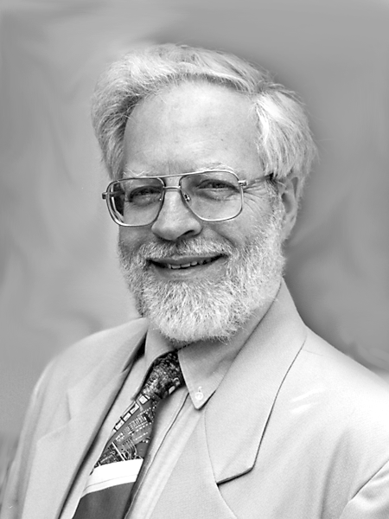
David Gries (Karlstrom '95, SIGCSE '91)
Hello! Nice to hear from you.
I never teach bubble sort. I see no reason to teach it. There are a lot more important things that I think students should see. When it comes to initial discussions of sorting, I teach selection sort and insertion sort.

Slide 26
Kind words for Bubble sort?
However, the bubble sort is easy to remember and to program, and little time is required to complete a single step.
  Sorting, ACM Computing Surveys, 1971
However, we assume that the number of items to be sorted is moderately large. If one is going to sort only a handful of items, a simple strategy such as the O(n²) “bubble sort” is far more expedient.
Aho, Hopcroft, Ullman, Algorithms, 1974
Nevertheless, this sorting algorithm is commonly used where the value of n is not too large and programming effort is to be kept to a minimum. … The bubble sort has the additional virtue that it requires almost no space in addition to that used to contain the input vector.
  Stanat and Mcallister, Discrete Math for CS, 1977

Slide 27
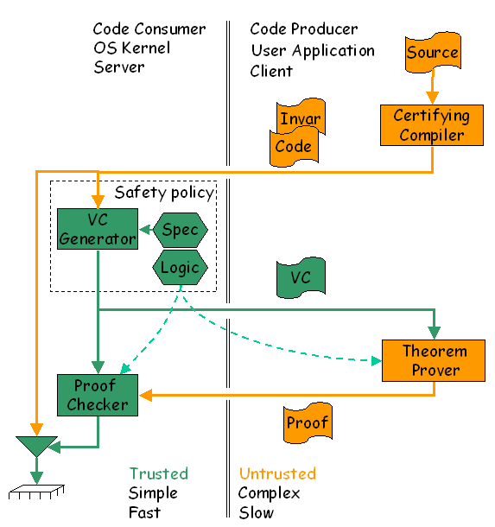
George Necula (Hopper Award 2001)
I am not sure what kind of comments you are looking for. I myself, do not like bubble sort and I prefer insertion sort, because it is easier to explain what the invariant is and why it is preserved at each step. I do think there is room in the curriculum for teaching O(n²) sorting algorithms, because they are simple. But when it comes time to use them in practice why would anyone implement any sorting with the convenient availability of quicksort in all respectable libraries?

Slide 28

Nell Dale (Karlstrom '01, SIGCSE '96)
Your discussion mentions and discards the premise that bubble sort is valuable because it is O(n) when the data is sorted or almost sorted, because insertion sort is better under these conditions. My comment relates to this property. .... Letting students see that an algorithm can be made "smarter" is a valuable lesson. So give bubble sort its due: it makes other sorts look better and it gives the students a lesson in algorithms.

Slide 29

What do we teach in CS1?
Take only memories, leave only …
  What memories?
Copyright term extension act
  Wrong course?
Is there a place for “bad” algorithms?
  Exemplars of best practice?
Three things in my course:
  1 + 2 + … + N = N(N+1)/2
  2¹⁰ = 1024
  The answer to most question is “it depends”

Slide 30

Peter Denning (Karlstrom ’96, SIGCSE ’99)
I first heard the term bubble sort when I was a grad student at MIT, approximately 1964. We considered it to be the same as the exchange sort, but with an onomatopoetic name to help visualize the process by which it worked. …
The moral was that the conceptually simplest or most obvious algorithm is not always the most efficient; in fact, your quick and dirty solution might be too slow to be useful.

Slide 31
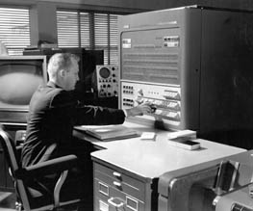
Dan McCracken SIGCSE ’92, CPSR ’89
In Programming Business Computers (1959, with Harold Weiss and Tsai Hwa Lee) we described it, but called it exchange sorting. I think the analysis is correct. If Big-Oh notation was in use for such things at the time I certainly hadn't heard of it, but we said the average time was n(n-1)/2.
My 1957 Digital Computer Programming has nothing on sorting.

Slide 32

Robert Aiken (SIGCSE ’95)
Like most of my CS colleagues I would include it [bubble sort] in a collection of sorting methods as I showed why, though it is easy to understand, it is not efficient. I think that is an important point and one students should learn early - both for historical as well as pedagogical reasons.
Thanks for your note. I quickly perused your paper and found it well-written and enjoyable. Nice job!

Slide 33
Essentially “No Comment”
John McCarthy
  “Sorry, I can’t recall anything that would be helpful.”
Maurice Wilkes
  “I am sorry that I cannot help you with your query about bubble sort. Obviously, you will be consulting Donald Knuth.”
Richard Stearns
  “No comment.”
David Harel
  “Thanks for considering me, but I don’t have anything of interest on this”
Andy Tanenbaum
  “… I am not really a sorting guru”

Slide 34
Knuth on Bubble sort (from The Art…)
“In short, the bubble sort seems to have nothing to recommend it, except a catchy name and the fact that it leads to some interesting theoretical problems.”
The Art of Computer Programming: Vol. 3, Sorting and Searching
“From a mathematical standpoint, Demuth's thesis was a beautiful piece of work. … But from a practical standpoint, the thesis was of no help. In fact, one of Demuth's main results was that in a certain sense “bubble sorting” is the optimum way to sort. … It turns out that [all other sorting methods studied] are always better in practice, in spite of the fact that Demuth has proved the optimality of bubble sorting on a certain peculiar type of machine.”
The Dangers of Computer Science Theory

Slide 35
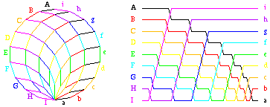
Crystalline structures = 2¹⁰ words

